Slide 1

2018
UMD Smith School of Business
Leadership Development Solution
Proposal

Slide 2





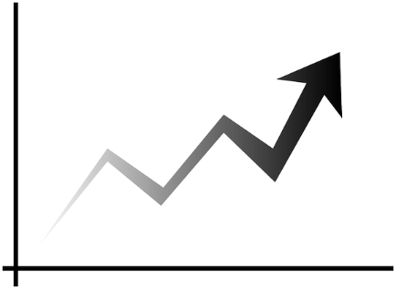
Our understanding of your needs
GOAL of UA Leadership Development Programs
Build a robust leader pipeline around the world that will “future proof” UA
so it is poised to anticipate and adapt to an uncertain and volatile business landscape
Program Requirements
More reach
Global & Scalable, reach the masses
More flexible
Ability to modify & adjust over time
More business trends
More relevance, less “academic”
More cost effective
Lower per person cost
More differentiation
VP v. Director

Slide 3
Our Proposed Approach
What we recommend:
Adaptability
Individual
Organizational
Trends & Insights
Sr. Director and below
Building Individual Adaptability
VP and above
Building Organizational Adaptability
UA Wide
Trends & insights in the business landscape
Notes:
A central, shared focus on Adaptability that shifts from a focus on individual development to organizational development with UA-wide talks around trends & insights in the business landscape

Slide 4
Details of the VP+ Program
Building Organizational Adaptability
Compress to 4.5 F2F sessions focused on solving an organizational challenge
Day 1: Intro to program, to the challenge, to their team, and to systems thinking followed by project identification.
Day 2: Implications Wheel and Project
Day 3: Gettysburg and Project
Day 4: Adaptability and Project
Day 4.5: Presentations to local executives
Classroom
Notes:
What is fueling adaptability?
Should we do experiential? Replaced with mini-simulation?
What is a closing experiential send off?
Are the teams made up of participants? Are these sessions intended to be over the phone?
Part of the sales pitch is to minimize travel…but would we be willing to travel ourselves?
I need to better understand why, other than cost savings, we are doing a 360 and not Hogan. Aren’t they both individual assessments? Isn’t our pitch that this will be about building organizational adaptability?

Slide 5
Details of Sr. Director- Program
Building Individual Adaptability
Each day will be a stand alone module. Under Armour will choose which sessions and how often they will be delivered. The frequency, scale, and overall cost of the program will be completely at the discretion of Under Armour.
Notes:
Do our experiential exercises have an intended theme?
Do we want to add any visuals of what the virtual content will look like? If they have seen elms, they probably won’t be terribly impressed.
What is the actual cadence of the coaching?
When will they take the Hogan?
It is odd to have detail for closing day 2 but not closing day 1.
What is the facility called where we will use their tech to run the virtual sessions?
Is offering the same experiential exercises impressive or not?
For opening day, is it safe to say it is the same as what is currently being delivered?

Slide 6
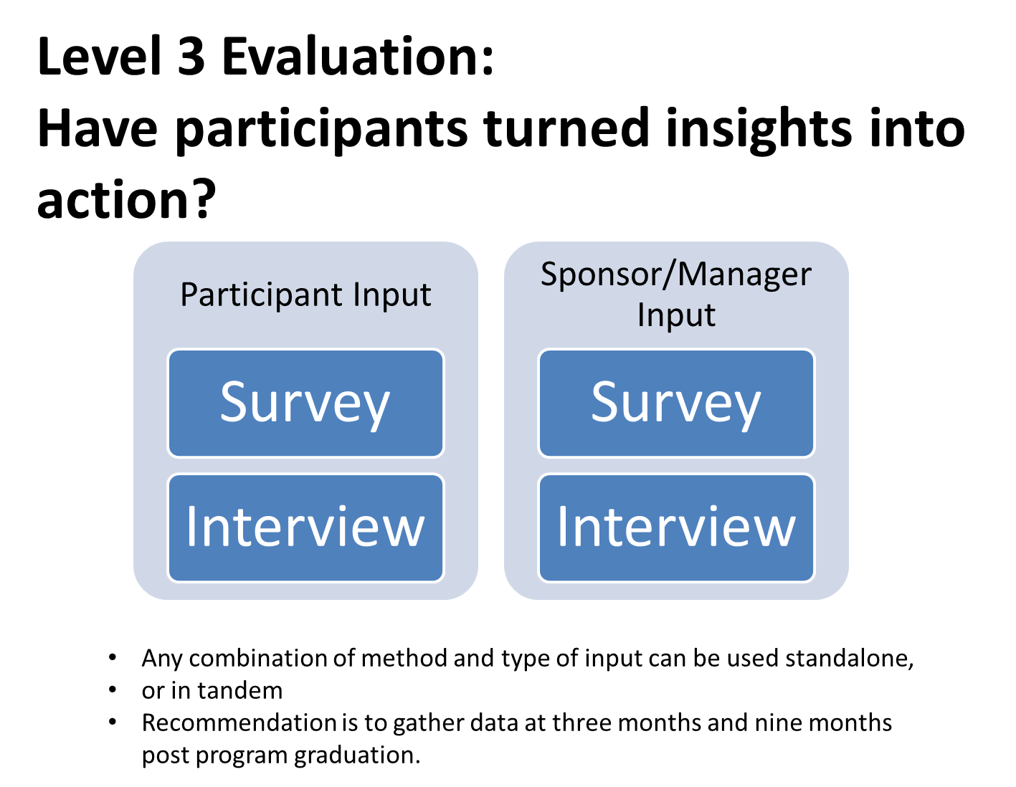
To assess IMPACT, we propose a new evaluation method
Notes:
Who surveys them and who interviews?
Can’t edit (photo) ---- Bullet points are one big sentence

Slide 7
Program Costs
Program | Length | Price per Day | Total Unit Price | Notes
VP Tuition | 3.5 Program Days for 30 Participants | $18,000 per Day | $63,000 | Price includes virtual materials, design and delivery of the program
Sr. Director Tuition | 5 Program Days for 45 Participants | $18,000 per Day | $90,000 | Price includes virtual materials, design and delivery of the program
VP & Sr. Director Design & Development |  | $35,000 per program | $70,000 | WAIVED
VP Coaching | 2 One-Hour F2F Sessions & 3 One-Hour Team Sessions per Participant (30 participants) | $450 per session | $67,500
360 Assessments |  | $250 per person | $7,500 | Priced at cost
Sr. Director Coaching | 2 One-Hour F2F Sessions & 4 One-Hour Pod Sessions per Participant (45 participants) | $450 per session | $67,500
Hogan Assessments |  | $400 per person | $19,000 | This includes $1,000 for Group Report – Priced at cost
VP Experiential Learning | ½ Program Day | $5,000 per ½ day | 5,000
Sr. Director Experiential Learning | 2 Program Days | $10,000 per day | $20,000
Armour Up Days | Keynote Speaker and 2 Cohort Breakout Sessions (2 days) | $9,000 per Half Day | $18,000
TOTAL COST OF VP PROGRAM | 3.5 Program Days, ½ day Experiential Learning, 5 hours of coaching per participant, 360, Armour Up |  | $152,000 | This cost reflects all available options including one Armour Up
TOTAL COST OF SR. DIRECTOR PROGRAM | 5 Program Days, 2 days Experiential Learning, 6 hours of coaching per participant, Hogan, Armour Up |  | $205,500 | This cost reflects all available options including one Armour Up
Notes:
What if we highlight the rows different colors to different each program, as it is it is a little bit difficult to follow. We need to keep in mind that this has to be 100% understandable weeks later, when we are not there to explain.

